Slide 1


Presented by Leena chatterjee

Slide 2
Agenda of discussion
What is MI
Type of machine learning
Project topic
Data types
Data visualization though univariate , bivariate and mulvariate graph plotting
Model Analysis
Best model selection
Hyper tuning
Calculate Final model and save final model
Summery
Challenges

Slide 3
What is MI ?
Machine learning is the study of computer algorithms that improve automatically through experience and by the use of data. It is seen as a part of artificial intelligence.

Slide 4
A study of machine learning
Machine Learning
Supervised
learning
Regression
Classification
Unsupervised
Learning

Slide 5
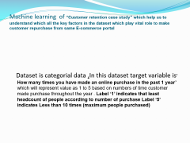
Machine learning of “Customer retention case study” which help us to understand which all the key factors in the dataset which play vital role to make customer repurchase from same E-commerce portal
Dataset is categorial data ,In this dataset target variable is’ How many times you have made an online purchase in the past 1 year’ which will represent value as 1 to 5 based on numbers of time customer made purchase throughout the year . Label ‘1’ indicates that least headcount of people according to number of purchase Label ‘5’ indicates Less than 10 times (maximum people purchased)

Slide 6
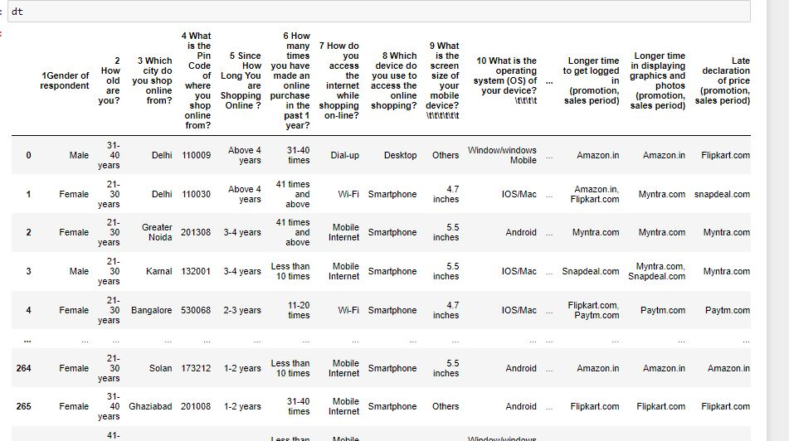
Data and datatypes:

Slide 7
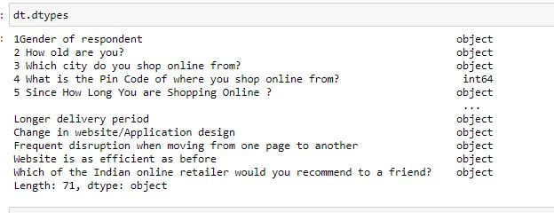
Datatypes:

Slide 8
Univariate analysis
Box plot-- In descriptive statistics, a box plot or box plot is a method for graphically depicting groups of numerical data through their quartiles. Box plots may also have lines extending from the boxes indicating variability outside the upper and lower quartiles, hence the terms box-and-whisker plot and box-and-whisker diagram.
Count plot- A countplot is kind of like a histogram or a bar graph for some categorical area. It simply shows the number of occurrences of an item based on a certain type of category

Slide 9
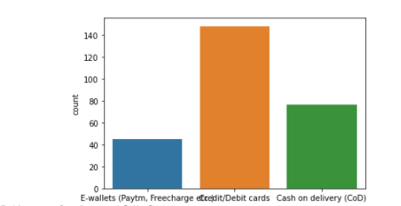
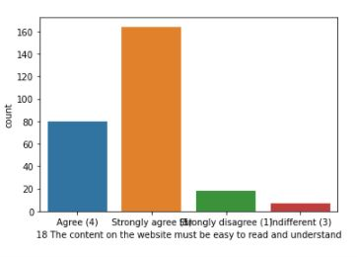
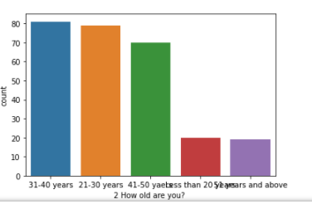
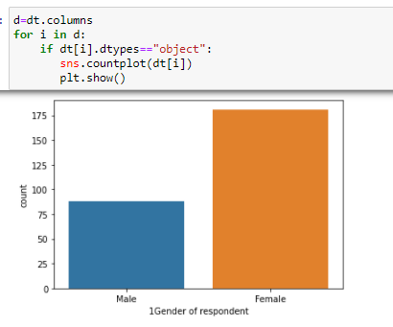
Countplot

Slide 10
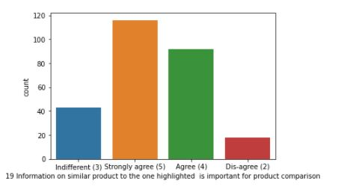
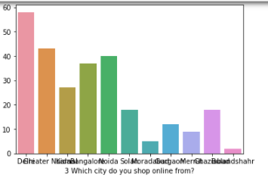
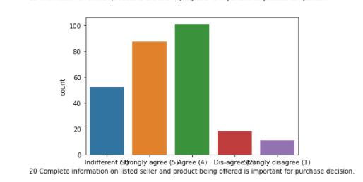

Slide 11
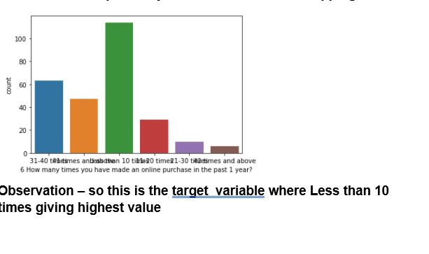
Target variable:

Slide 12
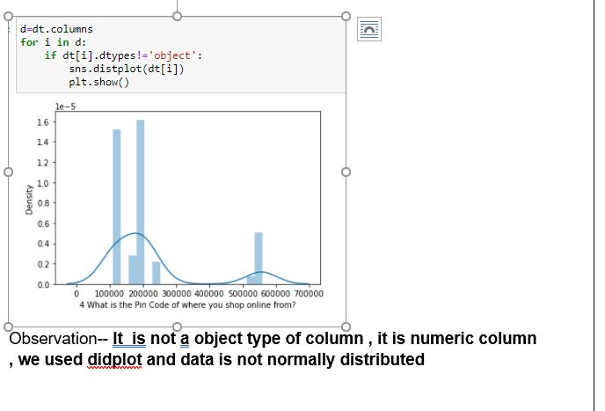
Displot :

Slide 13
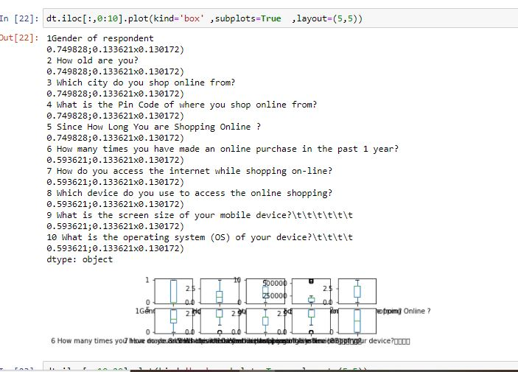
Boxplot:

Slide 14
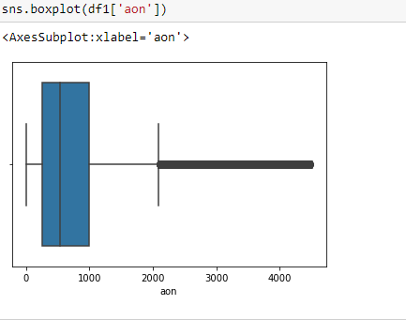
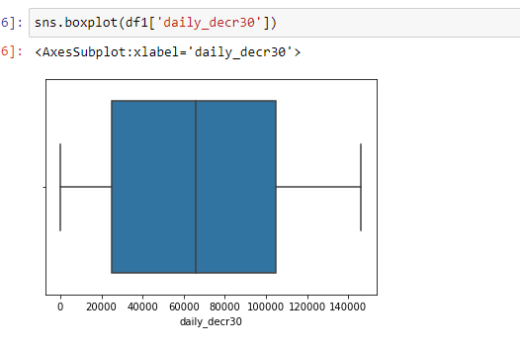
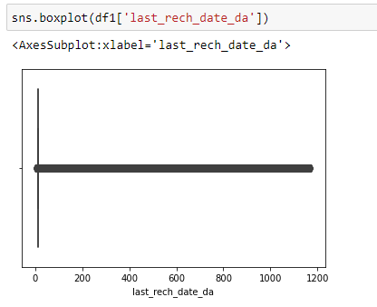
Boxplot:

Slide 15
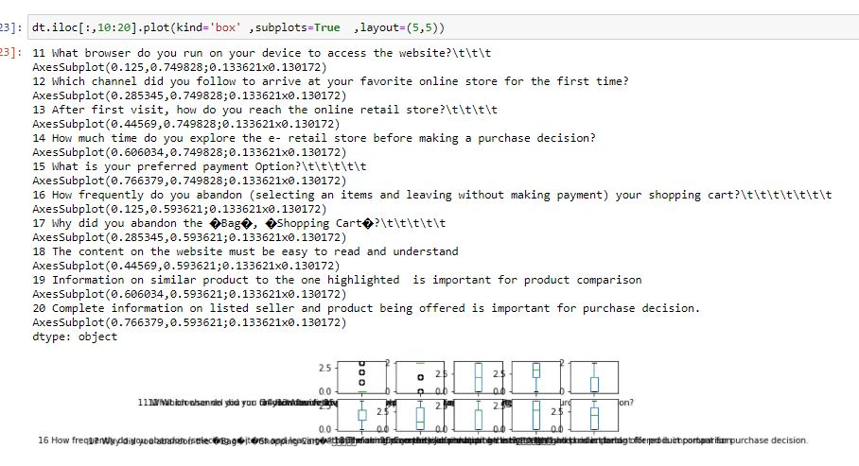
Boxplot

Slide 16
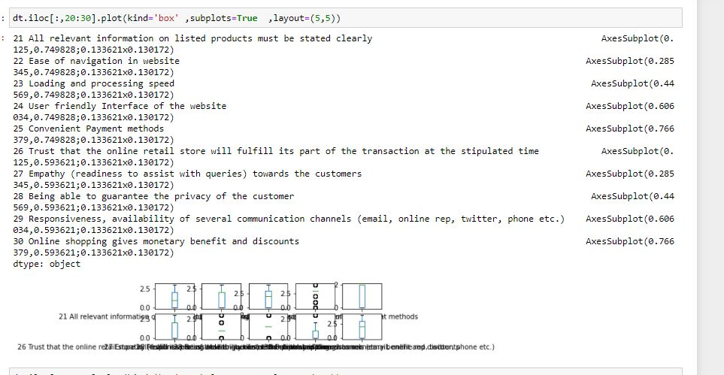
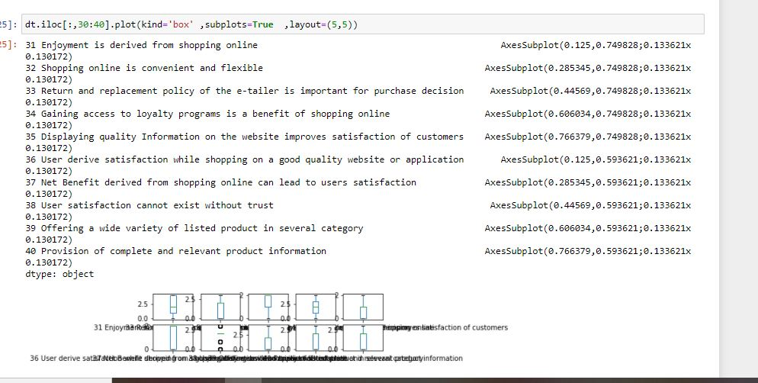
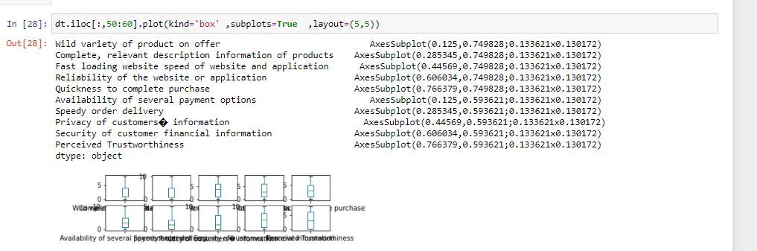

Slide 17
Bivariate analysis
A strip plot is a type of plot or mathematical diagram using Cartesian coordinates to display values for typically two variables for a set of data. If the points are coded, one additional variable can be displayed

Slide 18
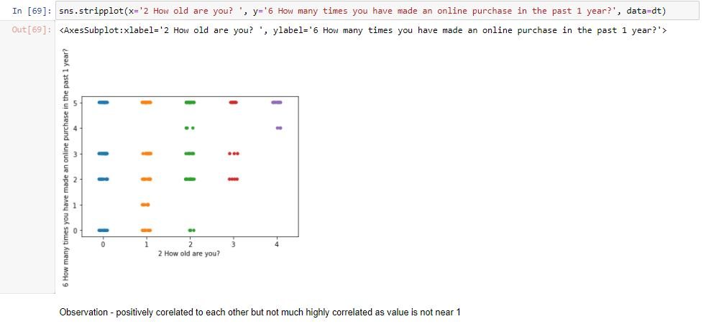
Stripplot

Slide 19
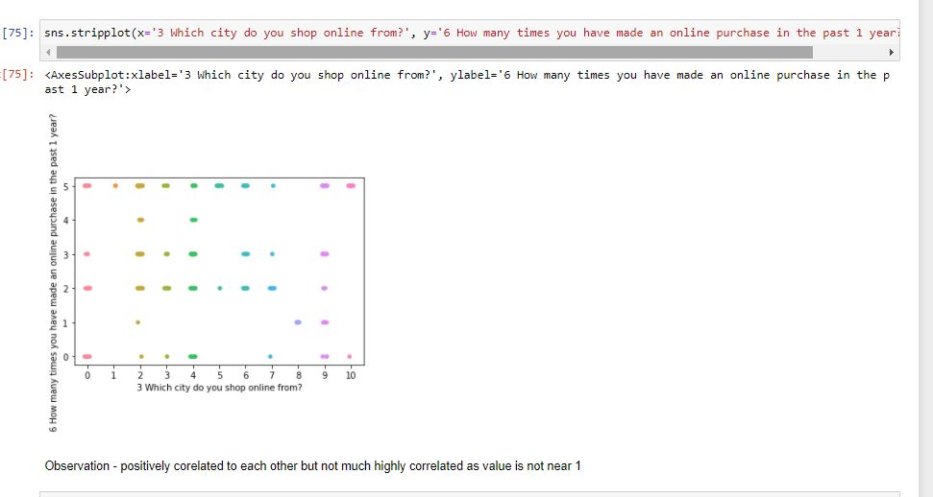
Stripplot

Slide 20
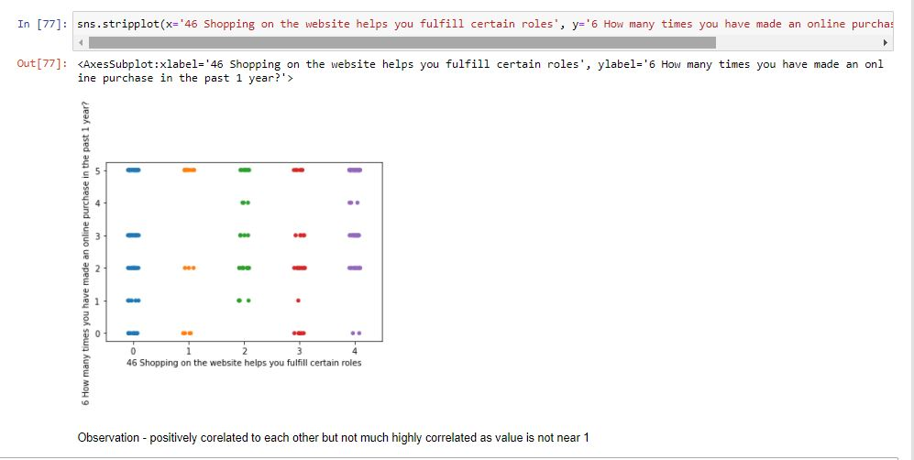
Stripplot

Slide 21
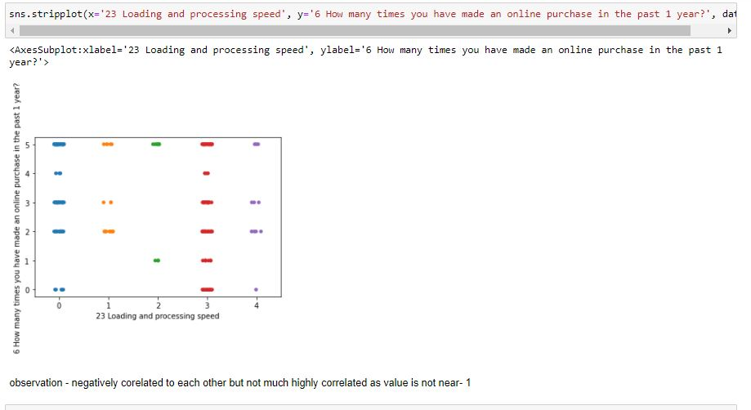
Stripplot

Slide 22
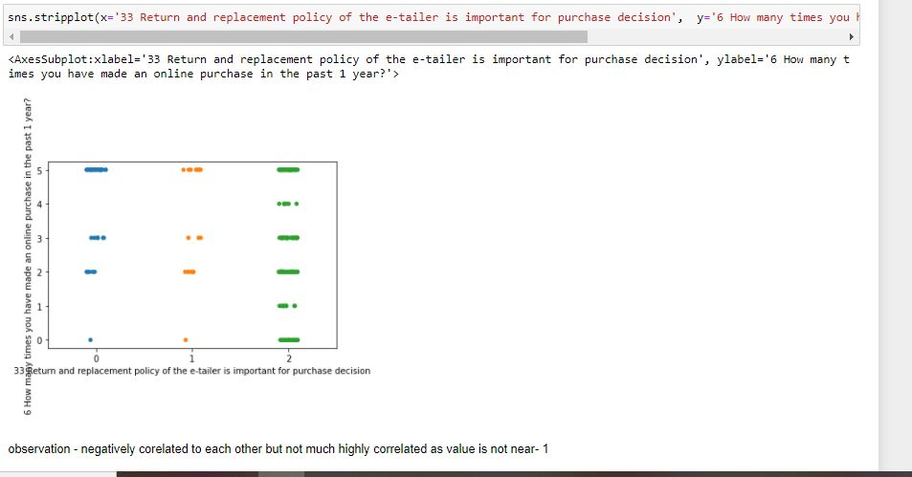
Stripplot

Slide 23
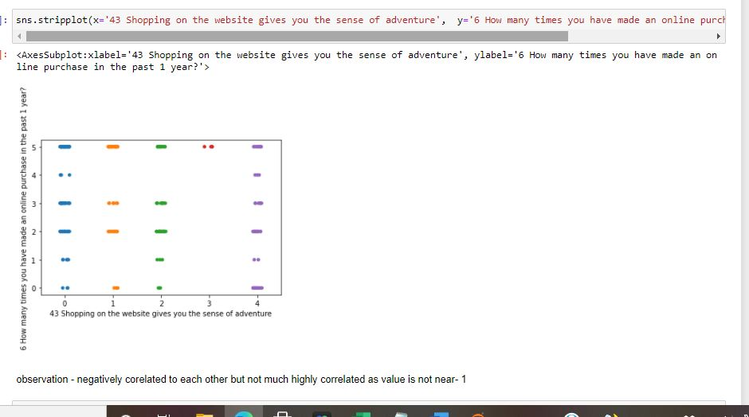
Stripplot

Slide 24
Multivariate Analysis
Heatmap
This visualization style came a long way from simple color-coded tables, it became widely used with data, and its commonly applied for describing density or intensity of variables, visualize patterns, variance.
Pairplot: A pair plot plot a pair wise relationships in a dataset. The pairplot function creates a grid of Axes such that each variable in data will by shared in the y-axis across a single row and in the x-axis across a single column

Slide 25
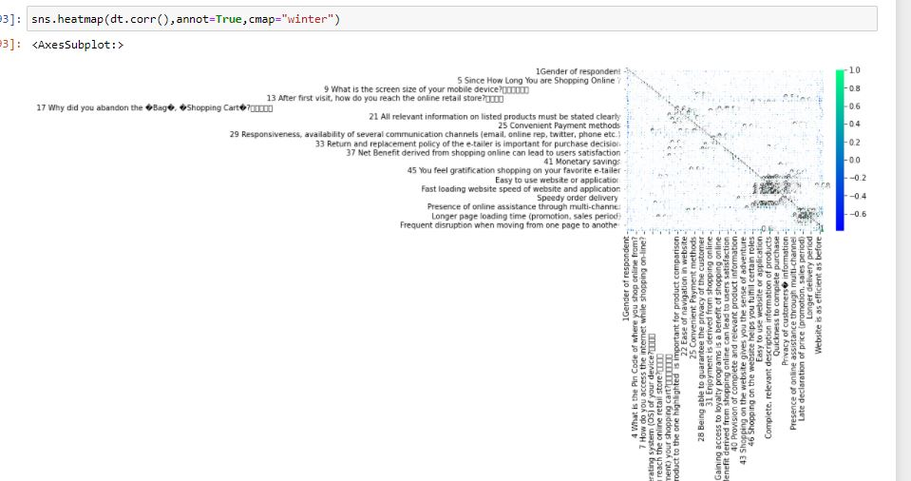
Heatmap
dfcor=df.corr()

Slide 26
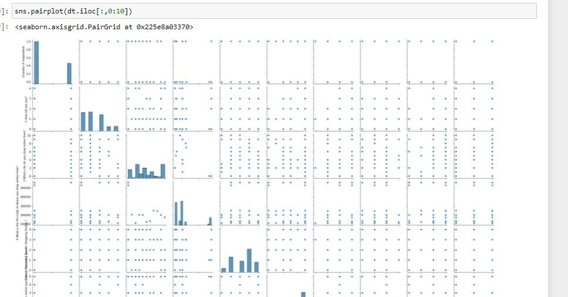
Pairplot

Slide 27
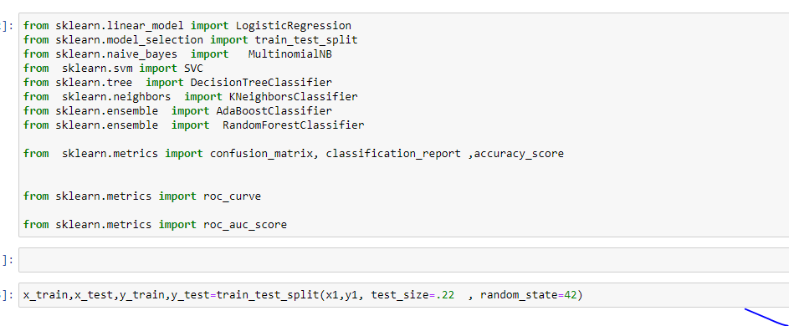
Train-test split
The train-test split is a technique for evaluating the performance of a machine learning algorithm. It can be used for classification or regression problems and can be used for any supervised learning algorithm. The procedure involves taking a dataset and dividing it into two subsets

Slide 28
Testing of Identified Approaches (Algorithms)
We have performed train test where we have send data to model ( some data for training and some for testing ). We have used 5 model inthis analysis
DecissionTree Classifier Model
Random Forest Model
Ada-boost Model
SVC Model

Slide 29
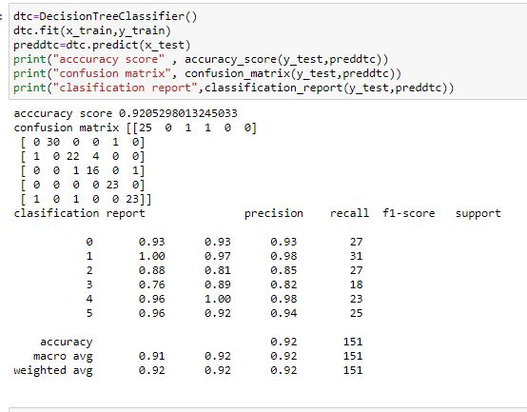
ALGORITHIM DecissionTree Classifier Model:

Slide 30
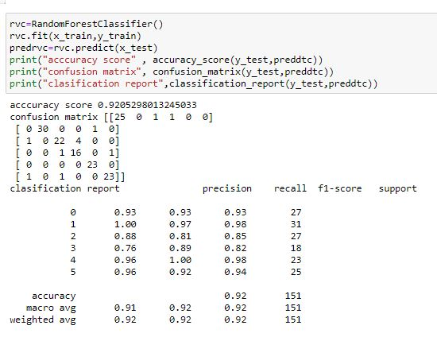
RandomForestClassifier

Slide 31
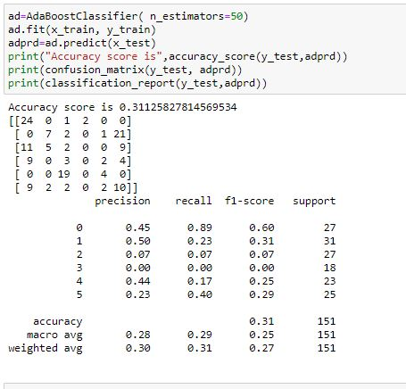
AdaBoostClassifier

Slide 32
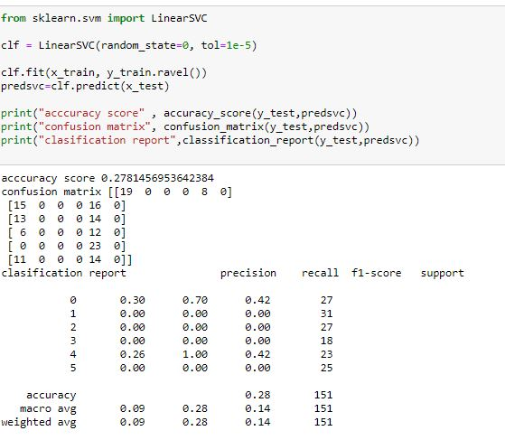
SVC

Slide 33
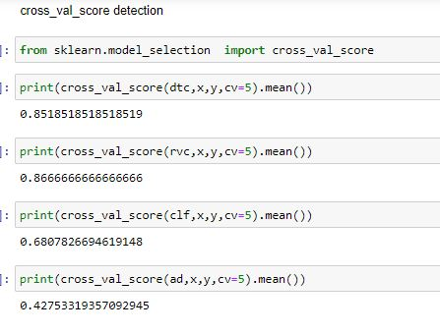
Cross Val score detection :

Slide 34
AS we will select best model where accuracy and cross val score will be minimum :

Slide 35
hyper tuning machine learning
We optimize model using hyper tuning parameter (hyper parameter optimization or tuning is the problem of choosing a set of optimal hyperparameters for a learning algorithm. These measures are called hyperparameters, and have to be tuned so that the model can optimally solve the machine learning problem)

Slide 36
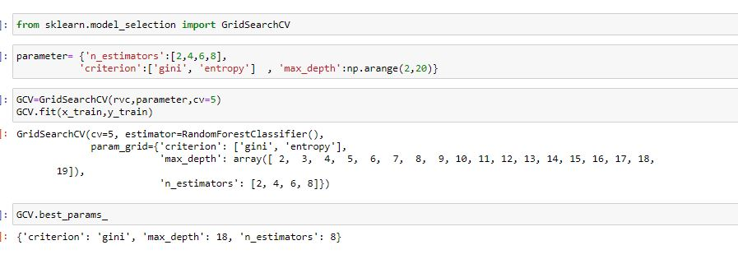
GridSearchCv

Slide 37
Final model selection and save final model :
Best Model Calculation: form analysis we found that RandonForestClassifier ,we are having less difference between accuracy and cross value score and from hyper parameter tuning we found (criterion= 'gini', max_depth= 18, N-Estimator=8) we will get best model

Slide 38
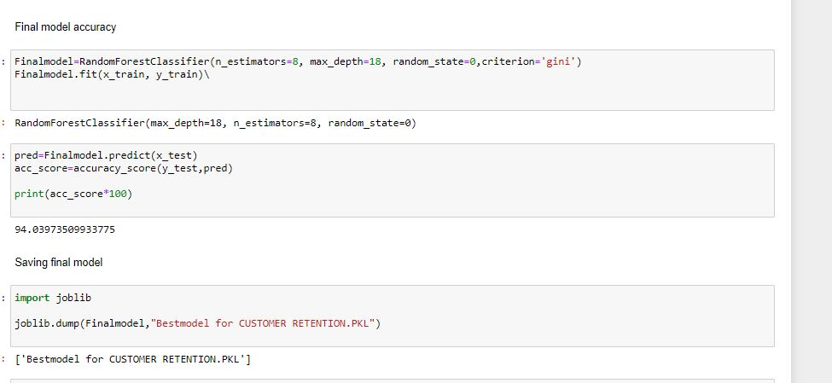

Slide 39
Summery
we have transformed categorical data to numeric using Label Encoder
We have plotted graphical view of each column to understand data distribution using count plot as well as for finding outlier concept we plotted boxplot
As this is categorical data we cannot remove outlier as mean concept not there in categorical data, same confirmed by Data Trained mentor
we divided data x and y as a data and target
we analysis all the model and found only RFC is having less difference between accuracy and cross_val_score
We optimize model using hyper tuning parameter (hyper parameter optimization or tuning is the problem of choosing a set of optimal hyperparameters for a learning algorithm. These measures are called hyperparameters, and have to be tuned so that the model can optimally solve the machine learning problem)
We got our final model

Slide 40
Challenges
The data could be incomplete. even the lack of a section or a substantial part of the data, could limit its usability.
We don’t get always accurate information as data might be not totally completed .
As it is real time data , it is complex data, took long time to execute

Slide 41


